Slide 1


“ Machine Downtime ”
By- Ragini Chouhan

Slide 2


Project Leadership
Bharani Kumar Depuru
Director & Co-Founder at Innodatatics | Chief Data Scientist
linkedin.com/in/bharanikumardepuru/
Mihir Jain
Associate Data Scientist Intern at Innodatatics
linkedin.com/in/mihirjain0405/

Slide 3

Contents
Introduction
Business Problem, Objective and Constraints
CRISP-ML(Q) Methodology
Technical Stacks
Project Overview and Scope
Data Collection and Understanding
Exploratory Data Analysis [EDA]
Data Preprocessing
Data Visualization
Notes:
Change

Slide 4
Introduction
What is Machine Downtime?
Definition: The time during which a machine or equipment is not operational or cannot perform its primary function.
Types: Planned Downtime vs. Unplanned Downtime
Impact: Reduced productivity, increased costs, and potential safety risks.
Importance of Analyzing Machine Downtime
Enhance Efficiency: Identify and reduce downtime to improve overall productivity.
Cost Savings: Minimize repair and maintenance costs.
Predictive Maintenance: Prevent unplanned downtime through early detection.
Competitive Advantage: Stay ahead in the market by optimizing machine performance.

Slide 5



Business Problem
“Machine which manufacture the pumps.Unplanned machine downtime which is leading to loss of productivity.”
Business Objective
Objective
Minimize unplanned machine downtime.
Constraints
Minimize maintenance cost.

Slide 6
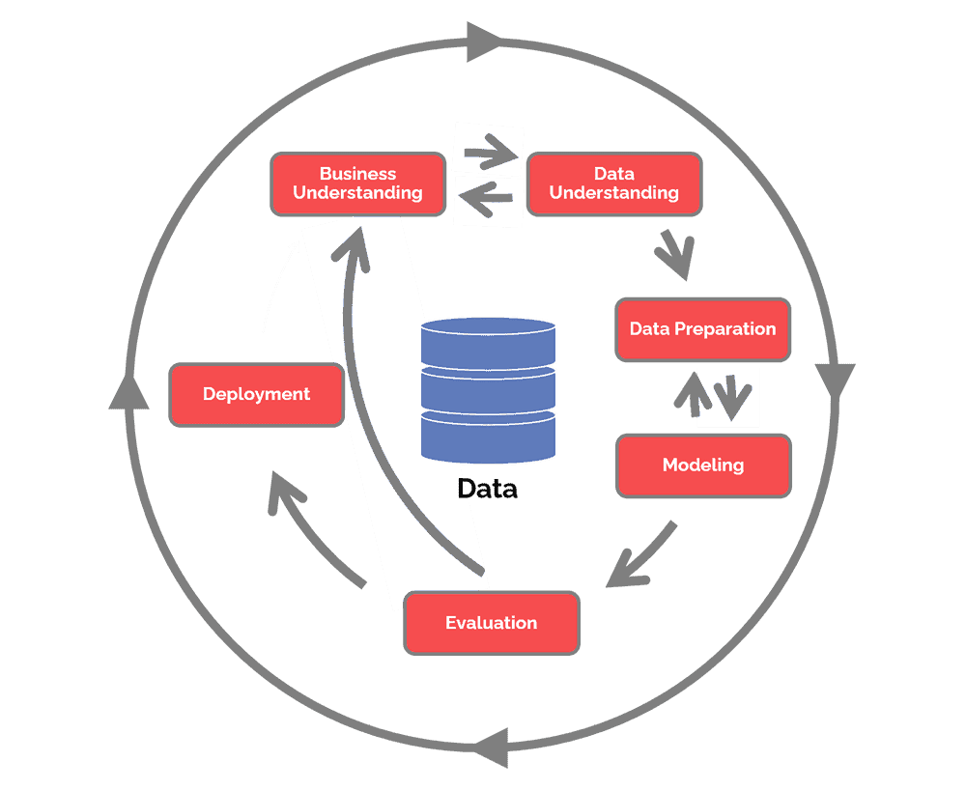
CRISP-ML(Q) Methodology
There are six stages of CRISP-ML(Q) Methodology
1. Business Understanding 2. Data Understanding
3. Data Preparation

Slide 7










Technical Stacks

Slide 8
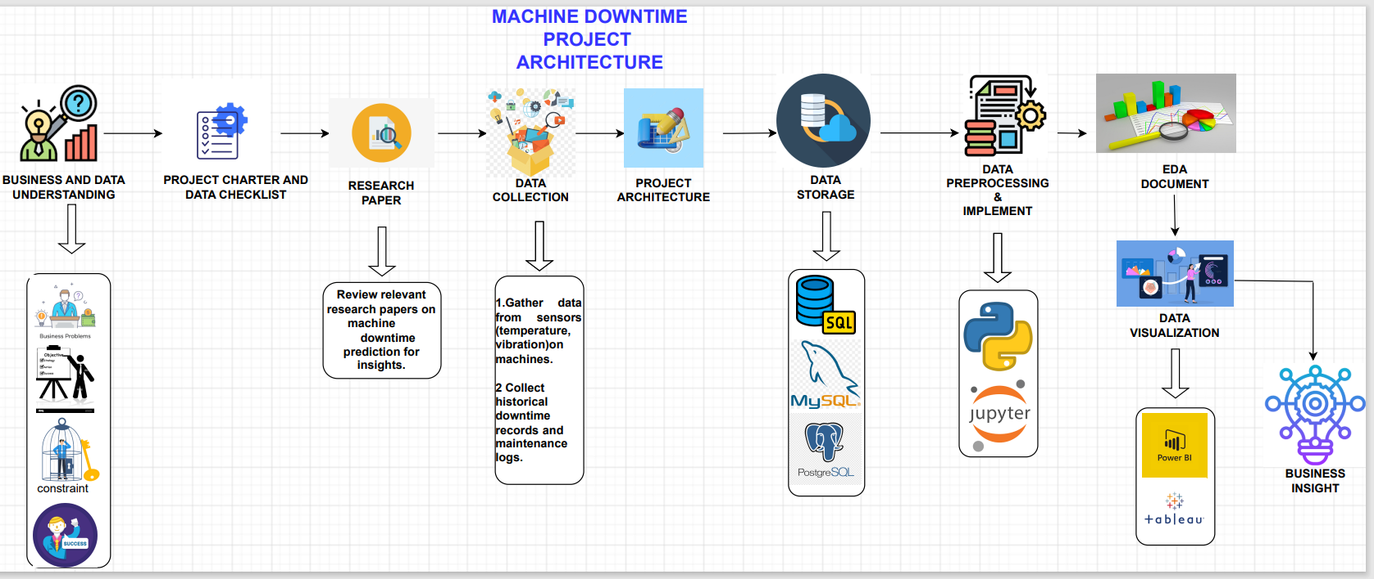
Project Overview and Scope

Slide 9
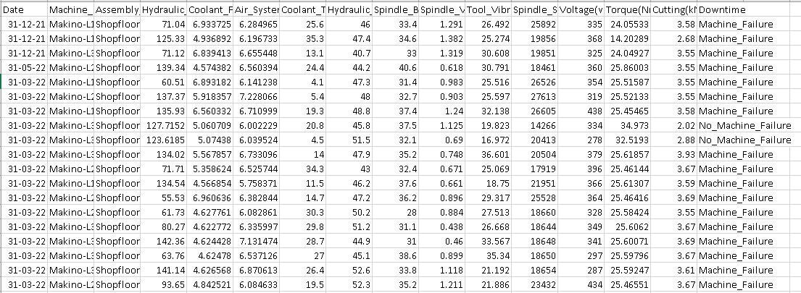
Data Collection and Understanding
Data Collection: Collect historical data on machine downtime, including timestamps, reasons for downtime, factors affecting machines, maintenance records, and any other relevant information.
Dataset is a comma separated file – Machine Downtime.csv
Sample screenshot of the data

Slide 10
Exploratory Data Analysis [EDA]
Total Records
2500
Total Features
16
Total Missing Values
152
Total Duplicate Records
0
Key Interfaces
Data Overview:
What is the size of the dataset (number of records and features)
What are the data types of each feature (numeric, categorical, datetime)?
Are there any missing values in the dataset?
Descriptive Statistics:
Calculated summary statistics for numeric variables (mean, median, standard deviation, etc.).
For categorical variables, find the unique categories and their counts.
Time Series Analysis:
Ploted a time series chart of machine downtime over time to identify trends or seasonality.
Distribution of Downtime:
Created a histogram or box plot to visualize the distribution of features.
Identified outliers or extreme values.
Categorical Analysis:
Grouped downtime data by machine type and calculated downtime statistics for each group.
Correlation Analysis:
Created a correlation heatmap to visualize relationships.
Notes:
EDA is used for seeing what the data can tell us before the modeling task.
Change

Slide 11
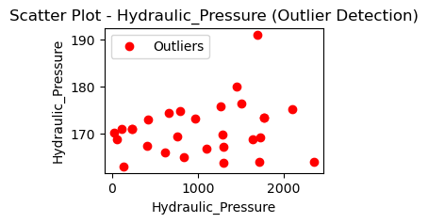
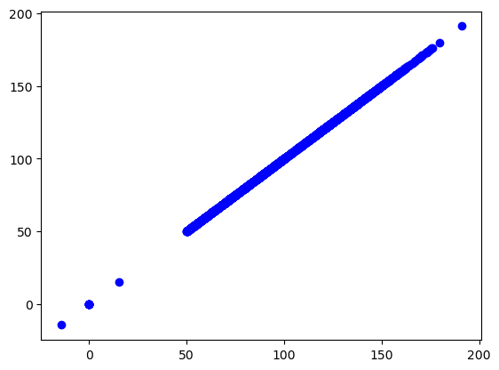

Data Preprocessing
Data is imported to mysql from csv file.
Established mysql connection in python
Data cleaning is performed on the dataset.
Imputed the missing values with mean values.
Identified outliers as values more than 2 standard deviations away from the mean.
Imputed outliers with mean values.
Notes:
Keep observations

Slide 12
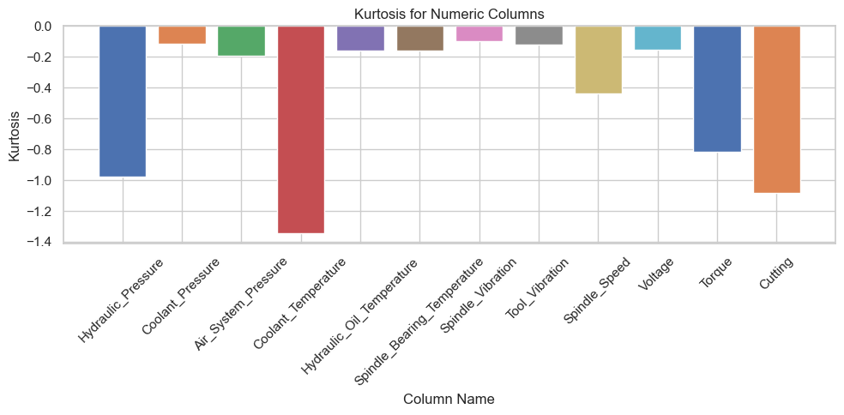
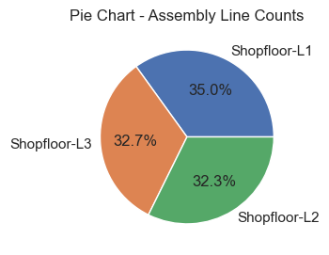
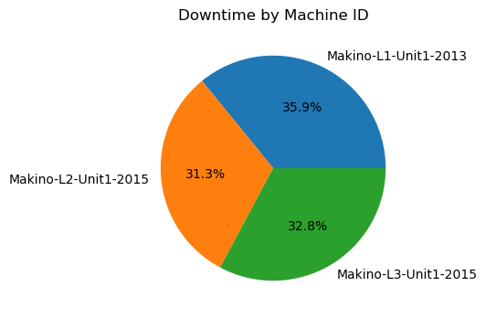
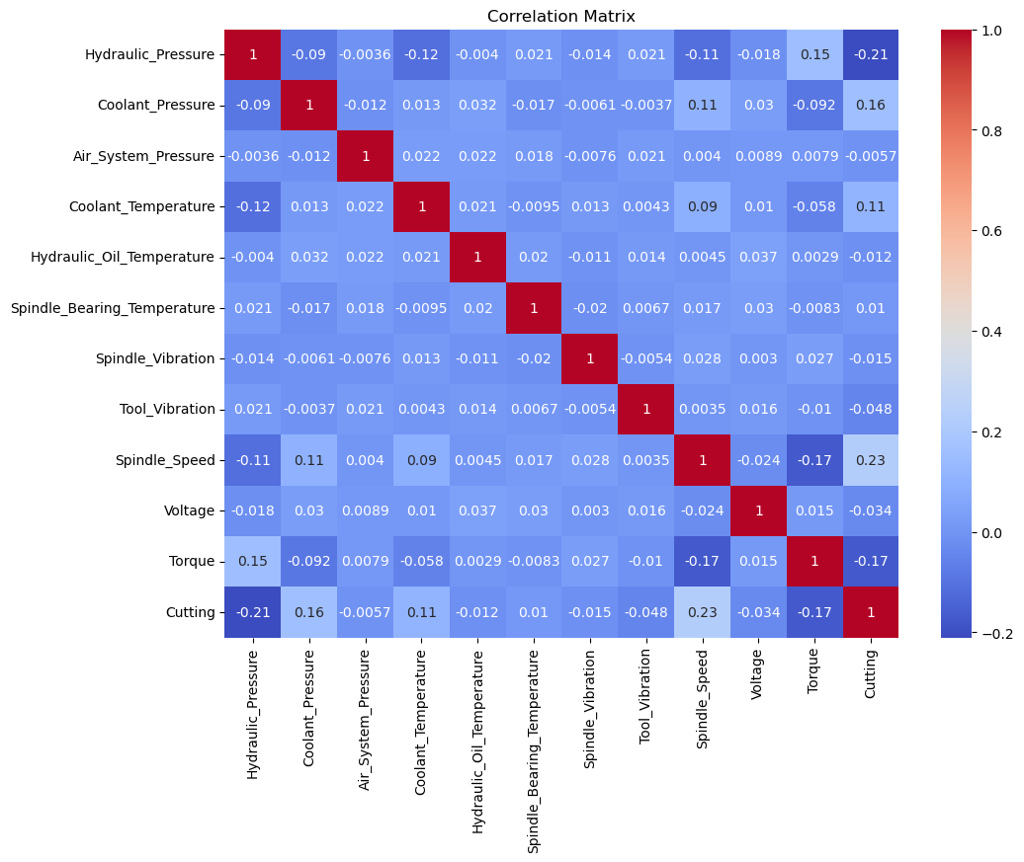
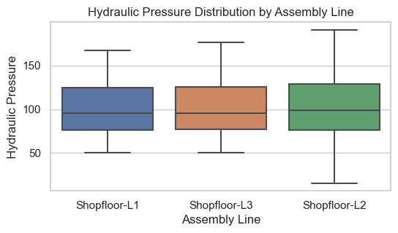
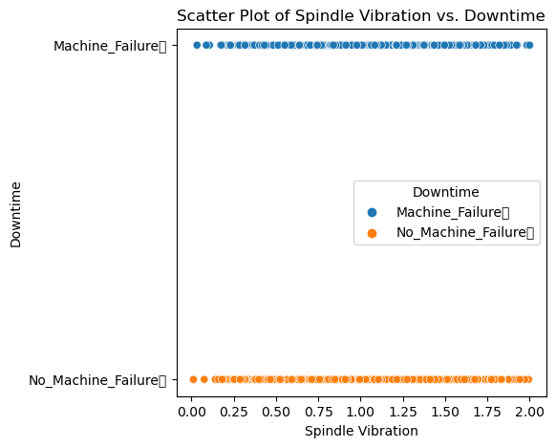
Data Visualization
Notes:
Add graphical

Slide 13


